Slide 1
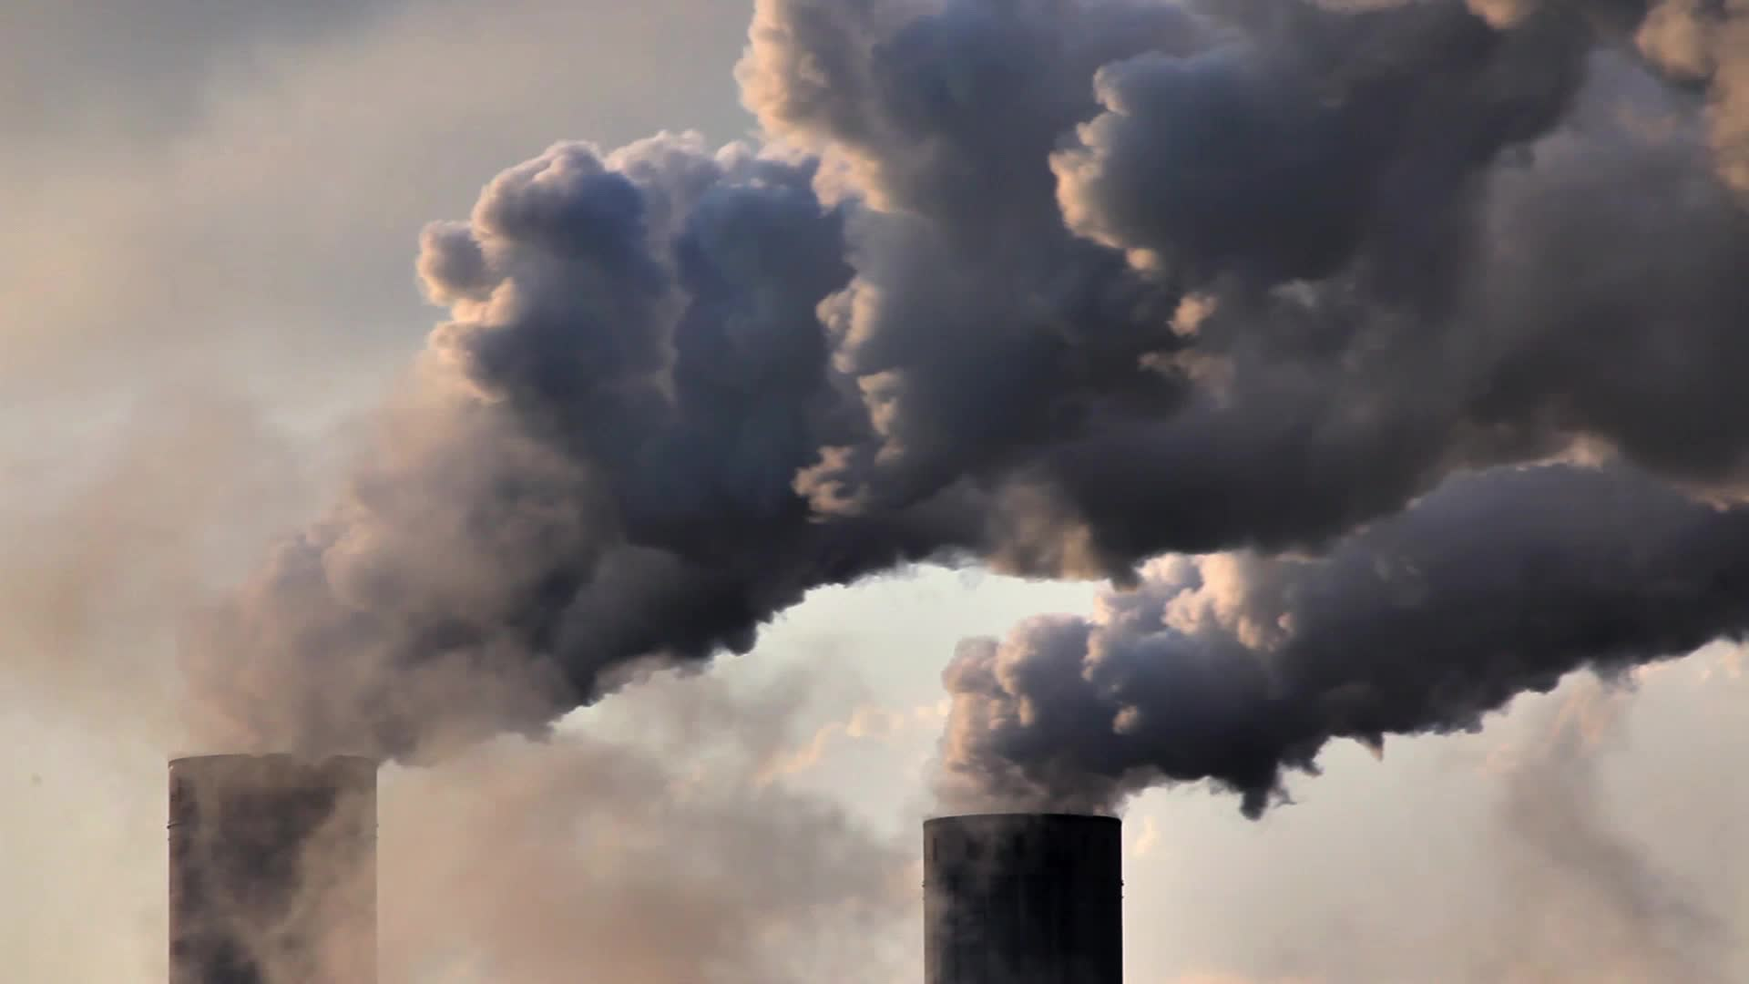
Global CO2 Emissions
By Group 6
Gopi Krishna Sajja (GXS220009)
2. Preet Paras Desa (PXD210046)
3. Snehal S Khapte (SXK220022)
4. Tanmayee Ashok Dharam (TXD220006)
5. Venkat Keerthan Boddu (VXB210054)

Slide 2
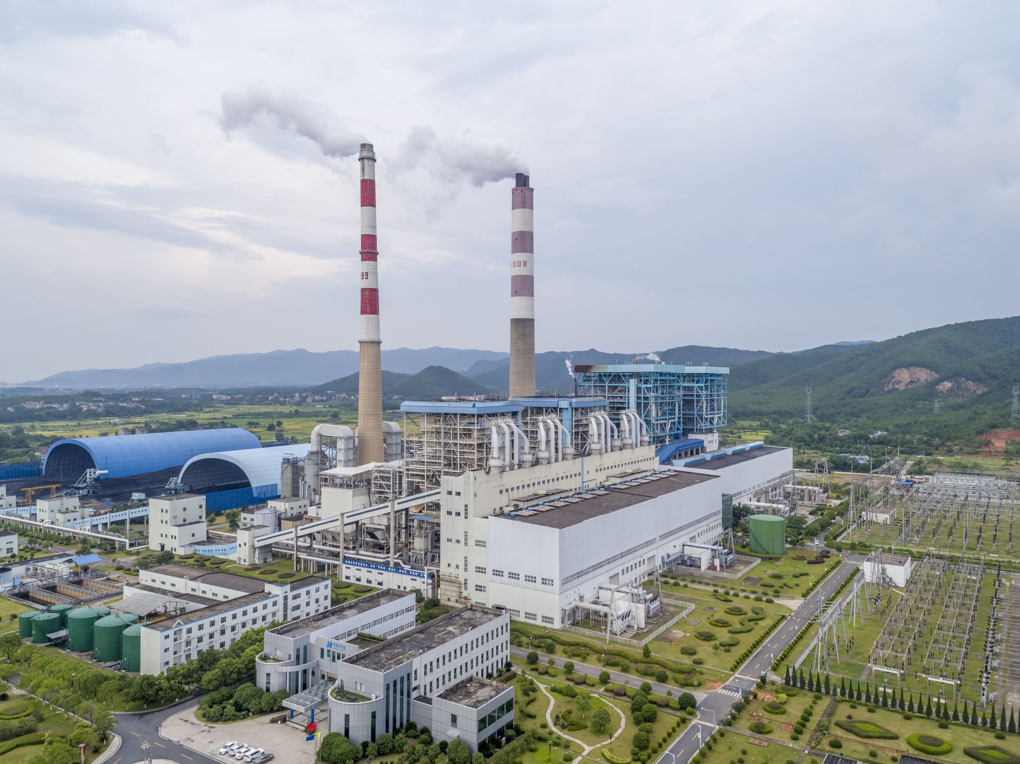
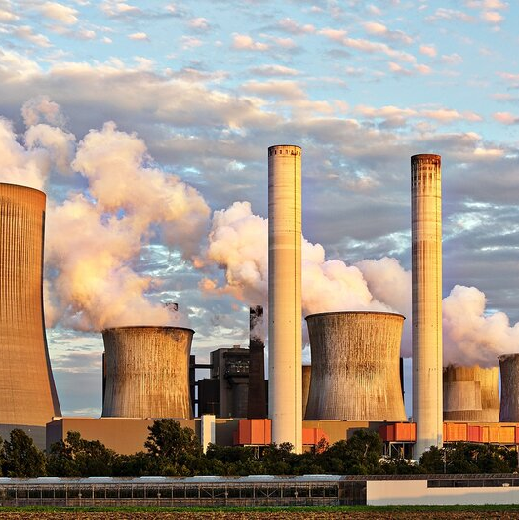

Introduction
Examine carbon emissions
Waste, Industrial Combustion, and Power Industry across multiple countries.
Identified the countries with the highest and lowest Carbon emissions in these sectors.
Impact on global temperature.
Drivers of carbon emissions.

Slide 3




4 Layer Architecture

Slide 4
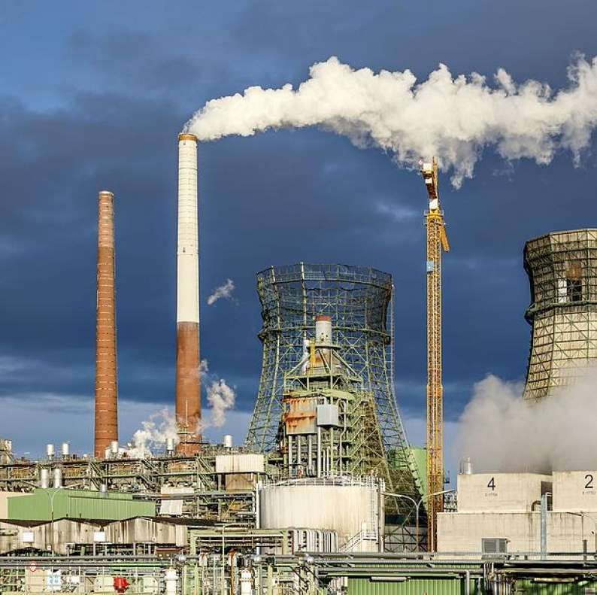
Co2 Emissions by Industrial Sector

Slide 5
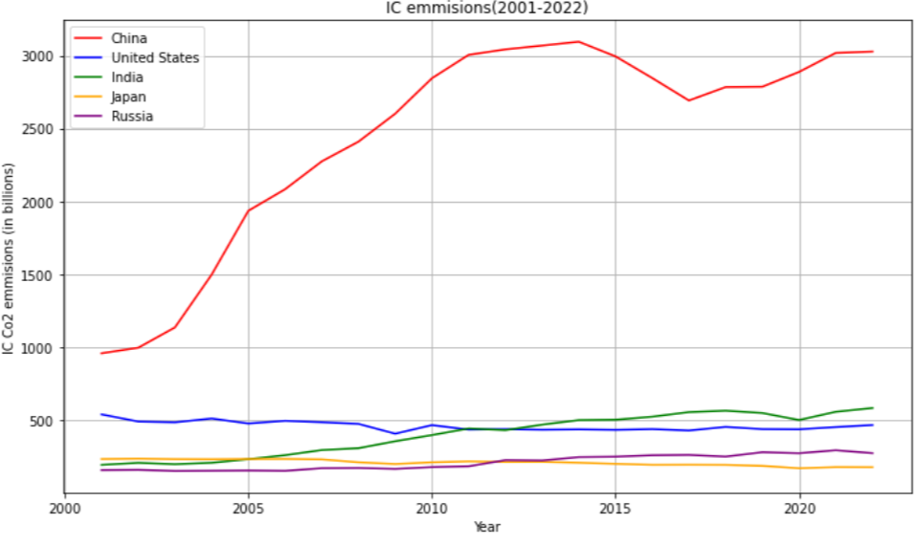
Co2 emissions by Industrial Combustion
The graph displays the top five countries that have the highest Co2 emissions through Industrial Combustion. It is evident that majority of the emissions are from China, US, Russia, India and Japan. Out of which China is the major contributor with almost 3000 Mt of Co2 released in 2022.

Slide 6
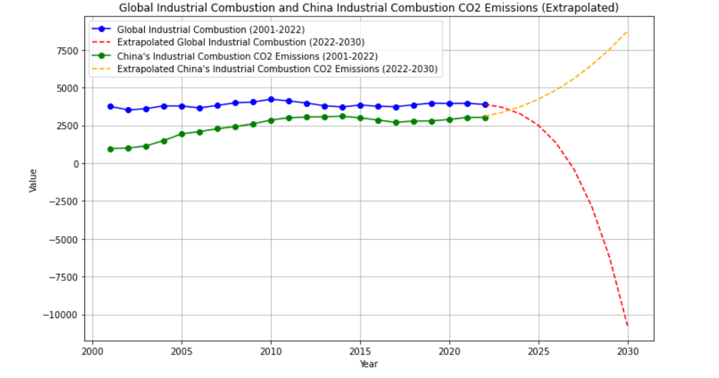
Extrapolation till 2030
We can clearly see that almost 40% of the world’s Co2 emissions through Industrial Combustion are from China.
The Co2 emissions from Industrial Combustion have increased over the years, by 2022 around 3500 Mt of Co2 is being emitted from Industries worldwide. Out of the 3500 Mt around 2500 Mt is from China.
This is due to variety of factors such as the Industrial boom in China which is attracting Industries from other countries to migrate to China.
The extrapolated results show that although the emissions worldwide are expected to decrease eventually but China’s emissions tend to increase. This suggests that focusing on China alone and taking measures that reduce these emissions would bring down the Co2 emissions drastically worldwide.

Slide 7
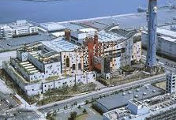

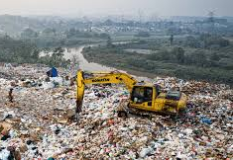
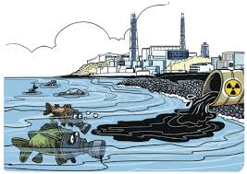
Carbon Emissions in the Waste Sector

Slide 8
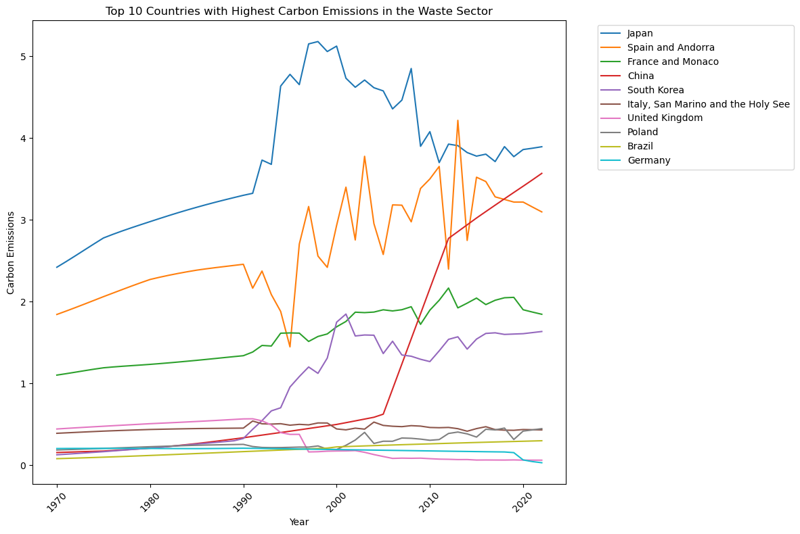
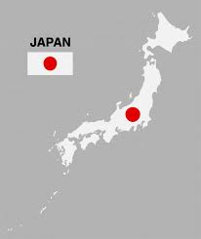
Best Waste Management Country

Slide 9
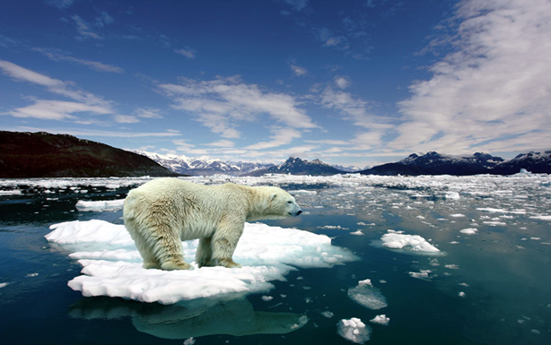
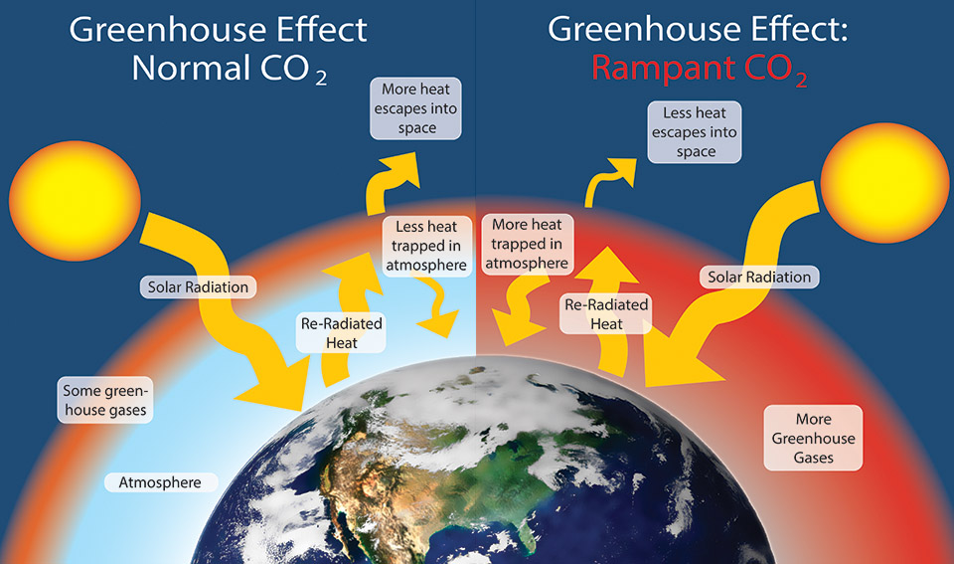

Global Temperature due to Co2 Emissions

Slide 10

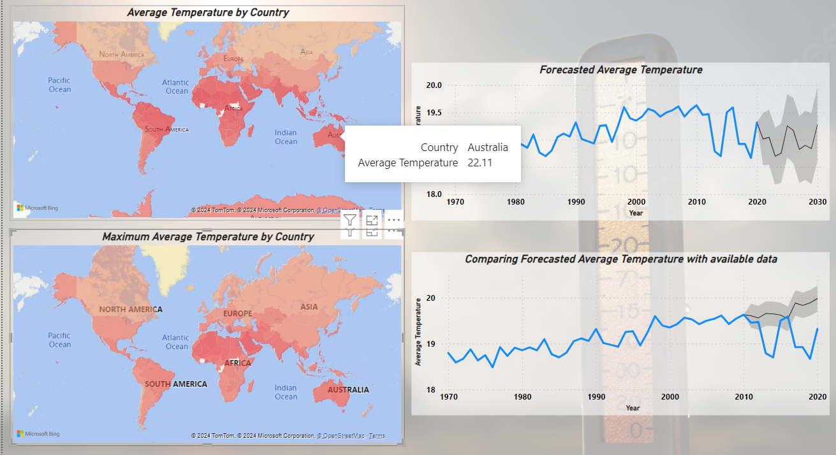
Dashboard for Global Temperatures

Slide 11
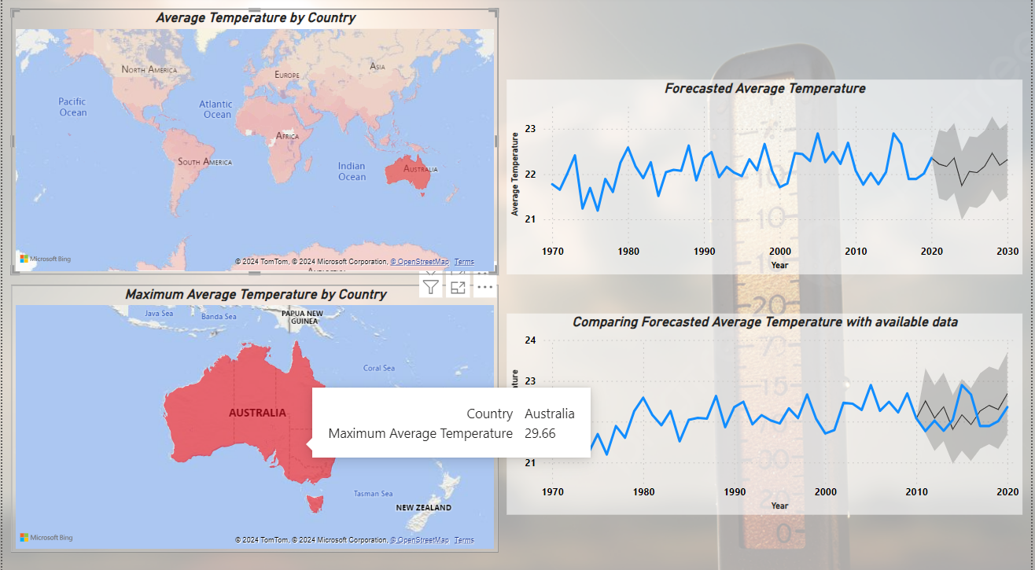
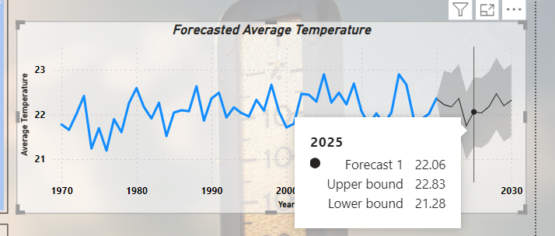
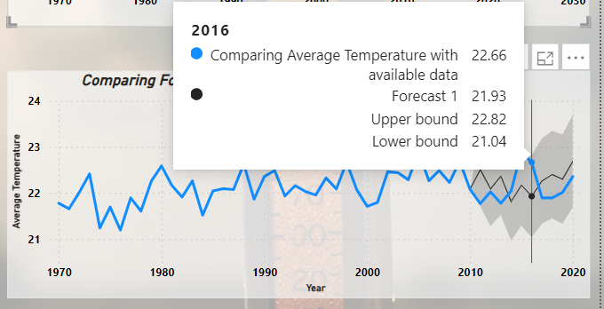

Slide 12
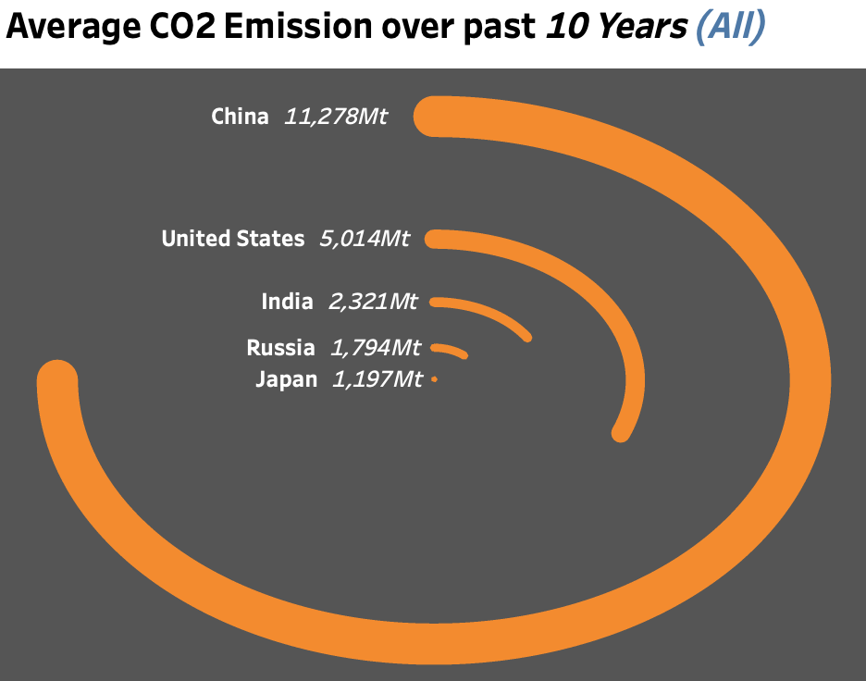
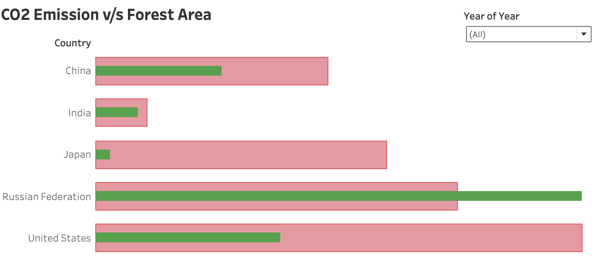
CO2 Emission for most polluting countries & their forest coverage Link

Slide 13
Recommendations
Transitioning to renewable energy sources like biomass to run industries. As of now coal is the major source to power the industries, which is also a great contributor to Co2 emissions.
Establishing Green Financing (Loans and Grants to Industries that promote environmental-friendly activities) will encourage Industries to tune their processes and implement methods that reduce their overall Co2 emissions.
Countries should focus on promoting waste reduction and recycling practices to minimize incineration, while also exploring technologies like Carbon Capture Storage (CCS) to address CO2 emissions from nuclear power plant operations or wastewater treatment processes.
Reduce CO2 Emissions: To mitigate the effects of global warming, implementing policies and practices that reduce CO2 emissions are crucial.
Monitor and Adapt: Continued monitoring of global temperatures and developing adaptation strategies to address the consequences of rising temperatures are essential.

Slide 14
THANKYOU!!

